Slide 1

Note: The data and information in this document is reflective of a hypothetical situation and client. This document is to be used for KPMG Virtual Internship purposes only.
Sprocket Central Pty Ltd
Data analytics approach
[Division Name] - [Engagement Manager], [Senior Consultant], [Junior Consultant]

Slide 2
Note: The data and information in this document is reflective of a hypothetical situation and client. This document is to be used for KPMG Virtual Internship purposes only.
Agenda
Introduction
Data Exploration
Model Development
Interpretation

Slide 3
Note: The data and information in this document is reflective of a hypothetical situation and client. This document is to be used for KPMG Virtual Internship purposes only.
Introduction
Customer Analysis
Number of bike purchases in 3 years / percentages purchases
Job industry category.
Wealth segments
Number of cars own on each states
Gender-Wise Distribution

Slide 4
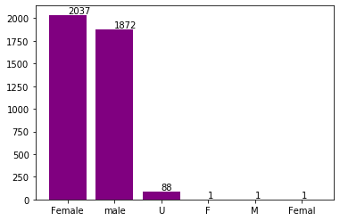
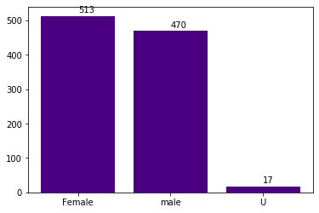
Note: The data and information in this document is reflective of a hypothetical situation and client. This document is to be used for KPMG Virtual Internship purposes only.
Data Exploration
Bikes purchase last 3 years
As we can see here from both datasets, the female customers are 2037 and 513 .
the male customers numbers as much as 1872 and 470.
Hence we should focus more on advertises of Female customers more than Male Customers.

Slide 5
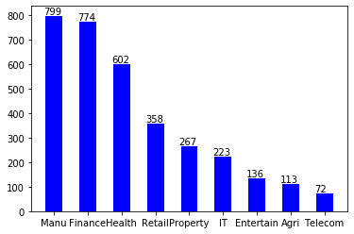
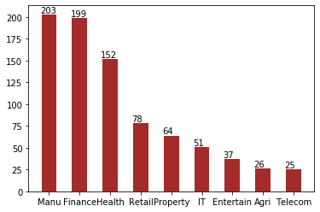
Note: The data and information in this document is reflective of a hypothetical situation and client. This document is to be used for KPMG Virtual Internship purposes only.
Model Development
Job Industry Category
As from our Data Analysis, Most of our new customers come from Manufacturing and Finance Industry. Health industry can also be considered as a good target for investing.
As for the rest of the industry,New customers appear to be same.

Slide 6
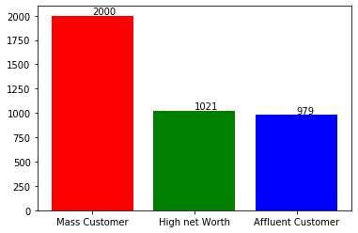
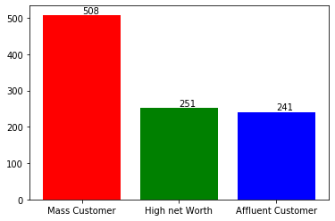
Note: The data and information in this document is reflective of a hypothetical situation and client. This document is to be used for KPMG Virtual Internship purposes only.
Interpretation
Wealth Segments
As we can see here, Number of customers are highest from Mass customer class. So we should focus on this social class.
Following mass customers is high net worth class.
Affluent customers are the ones from which we get least customers.

Slide 7
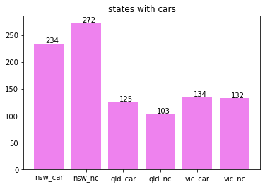
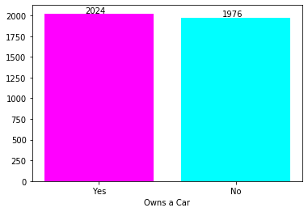
Note: The data and information in this document is reflective of a hypothetical situation and client. This document is to be used for KPMG Virtual Internship purposes only.
Interpretation
Number of cars owned
You can see here, NSW state has most people who own cars as well the ones who don’t own among other states.
Hence, investing in NSW is a very good strategy.
Residents from QLD and VIC who don’t own car is nearly same but still worth considering.
We can also see here that number of customers who owns and do not owns the car are nearly the same as being 2024 and 1976 from out dataset.

Slide 8
Note: The data and information in this document is reflective of a hypothetical situation and client. This document is to be used for KPMG Virtual Internship purposes only.
Appendix

Slide 9
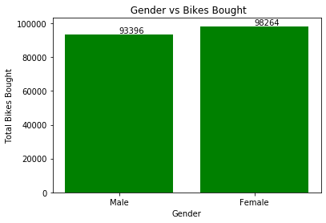
Note: The data and information in this document is reflective of a hypothetical situation and client. This document is to be used for KPMG Virtual Internship purposes only.
Appendix
Gender vs bike Purchased Quantity-wise distribution
By the Quantitative analysis, we can see here that number of bikes bought by male customer are 93396 while female is 98264.
There is significant gap by quantity in male and female customers and we should consider how to attract more female customers.

